Slide 1
Amazon Elastic Beanstalk

Slide 2
What is Elastic Beanstalk?
Elastic Beanstalk is a managed service offered from AWS for deploying web applications/ worker processes simply through an easy AWS console on different servers like IIS/Tomcat/Apache etc.
It is Easy to begin.
An easier way for developers to quickly deploy and manage applications in the AWS cloud.
Upload and launch applications to AWS in minutes
Retain control over the underlying infrastructure.

Slide 3
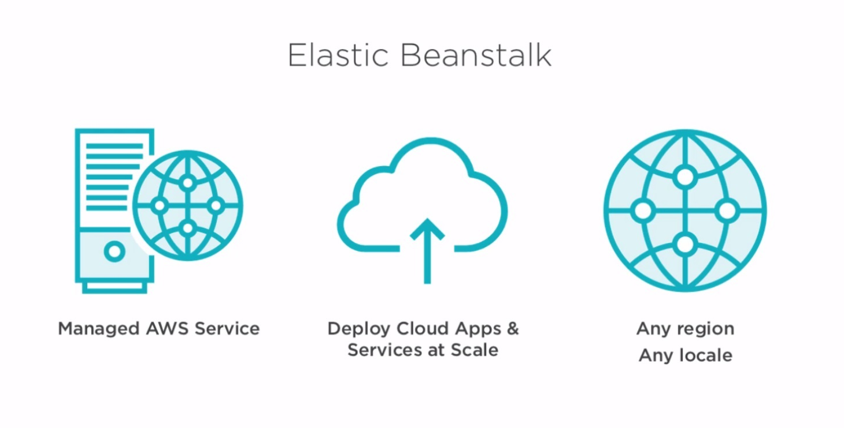

Slide 4
Supporting Platforms
Java,
.NET
PHP
Node.js
Python
Ruby
Go
Docker

Slide 5
Key Components
Application
Application Version
Environment
Environment Configuration
Configuration Template

Slide 6
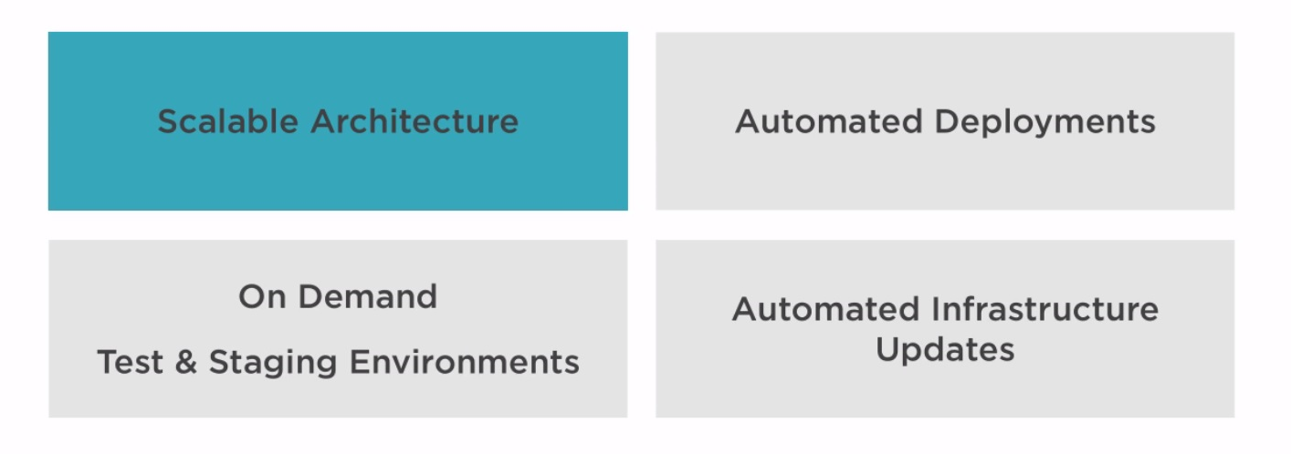
Key Features/ Advantages
Automatically handles
Details of capacity provisioning
Load balancing
Scaling
Application health monitoring

Slide 7
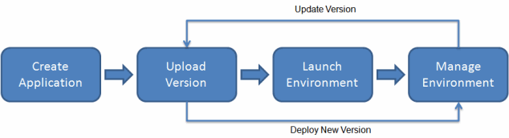
Process flow

Slide 8
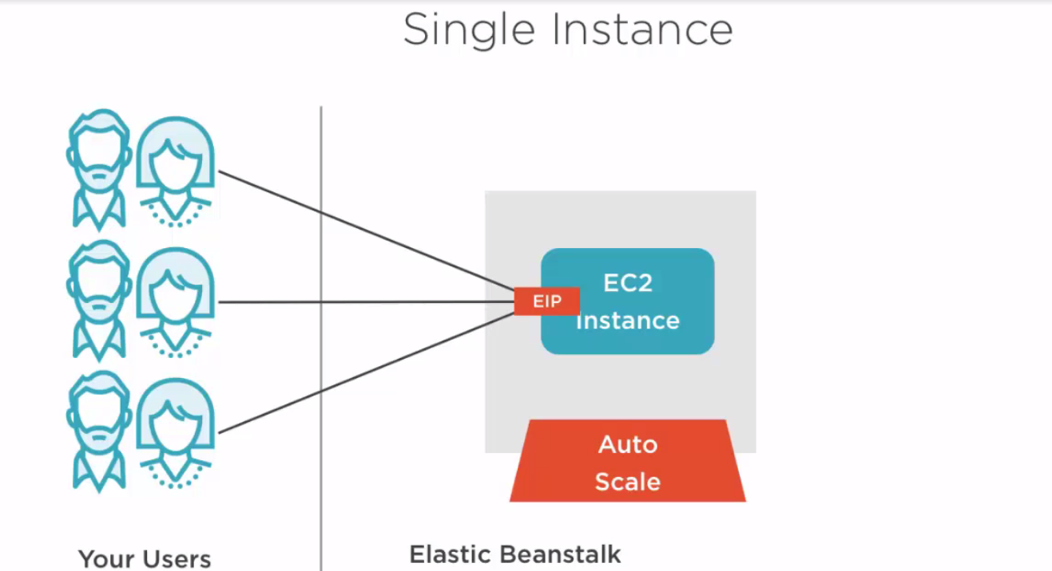
Typical Elastic Beanstalk Architecture

Slide 9
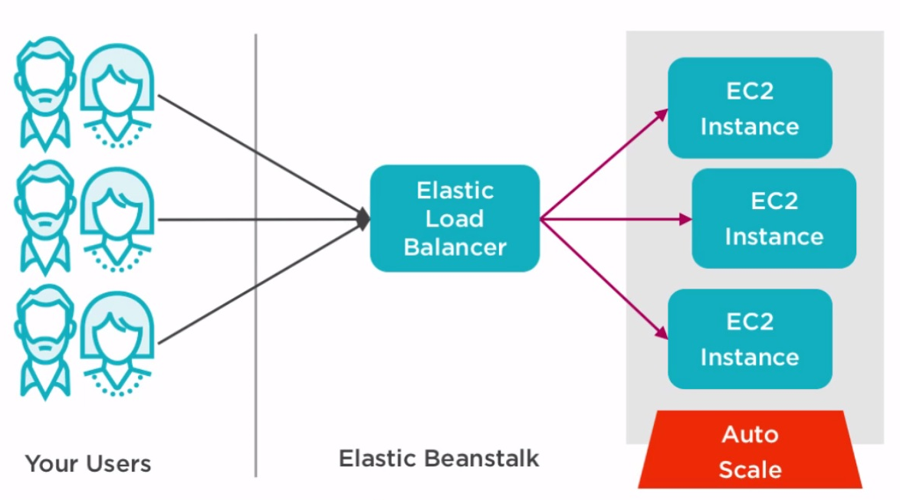
Typical Elastic Beanstalk Architecture

Slide 10
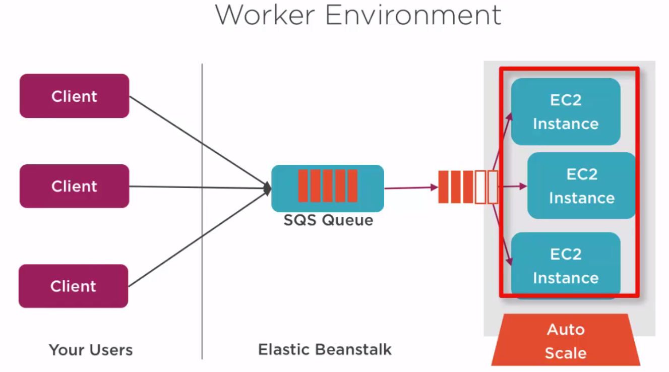
Typical Elastic Beanstalk Architecture

Slide 11
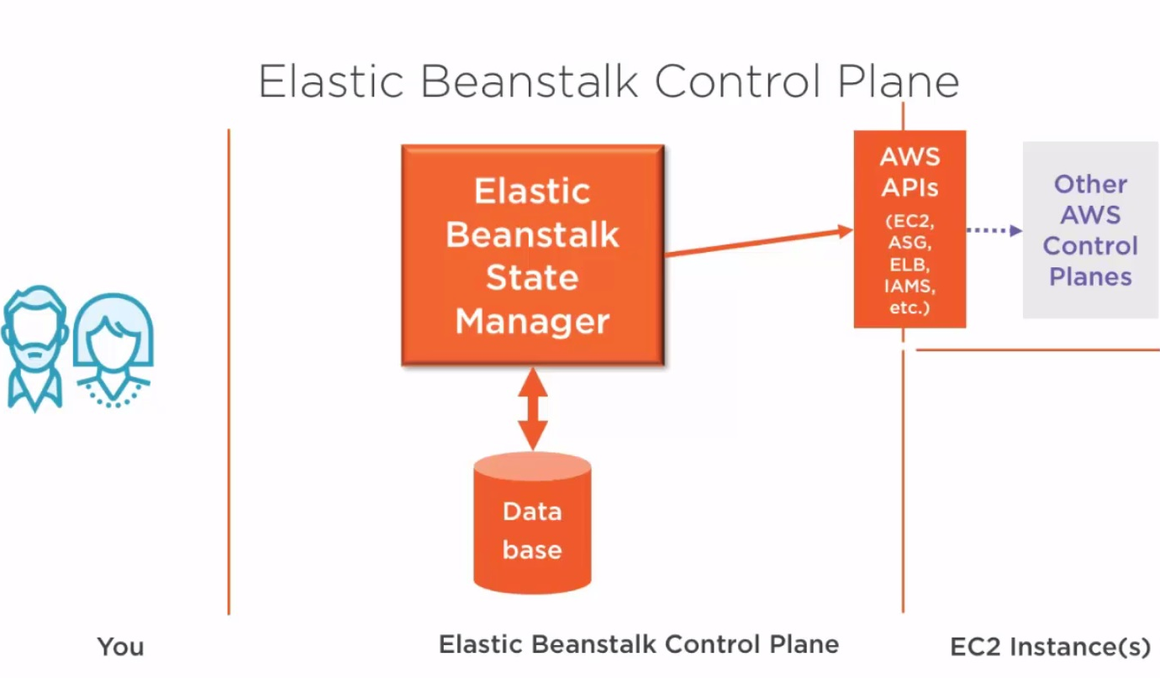
Typical Elastic Beanstalk Architecture

Slide 12
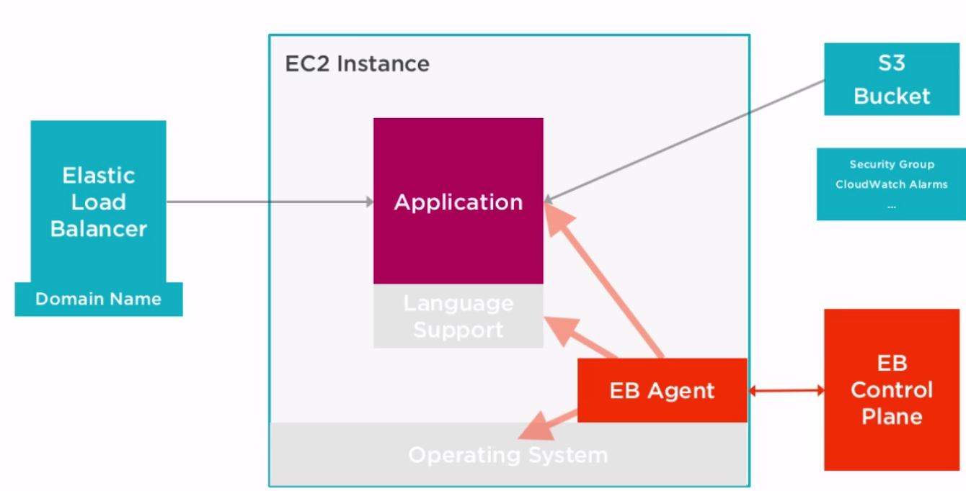
Inside Each EC2 instance

Slide 13
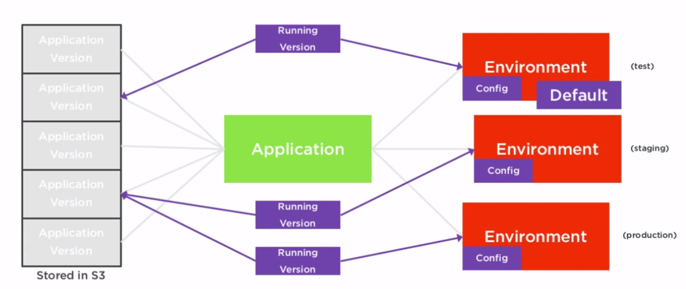
Elastic Beanstalk Terminology

Slide 14
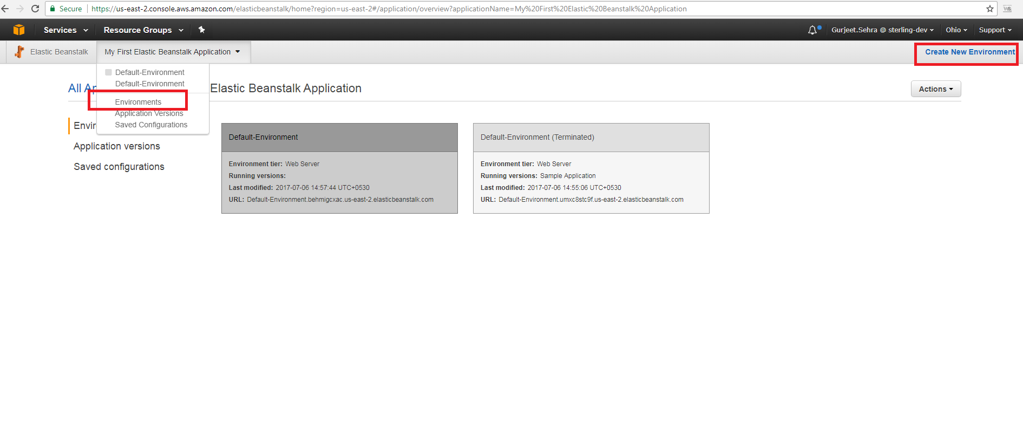
Creating Environment

Slide 15
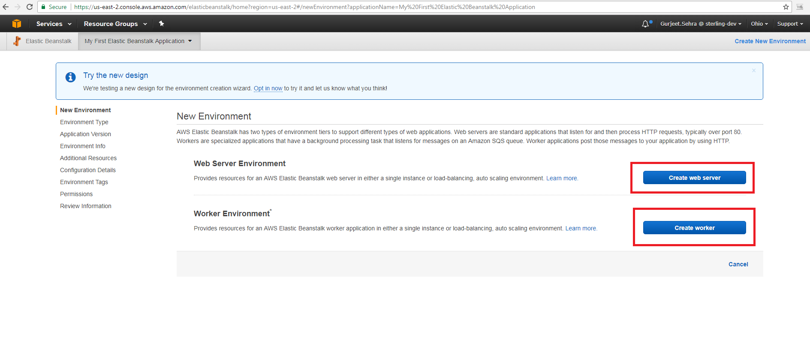
Creating Environment – Step 1

Slide 16
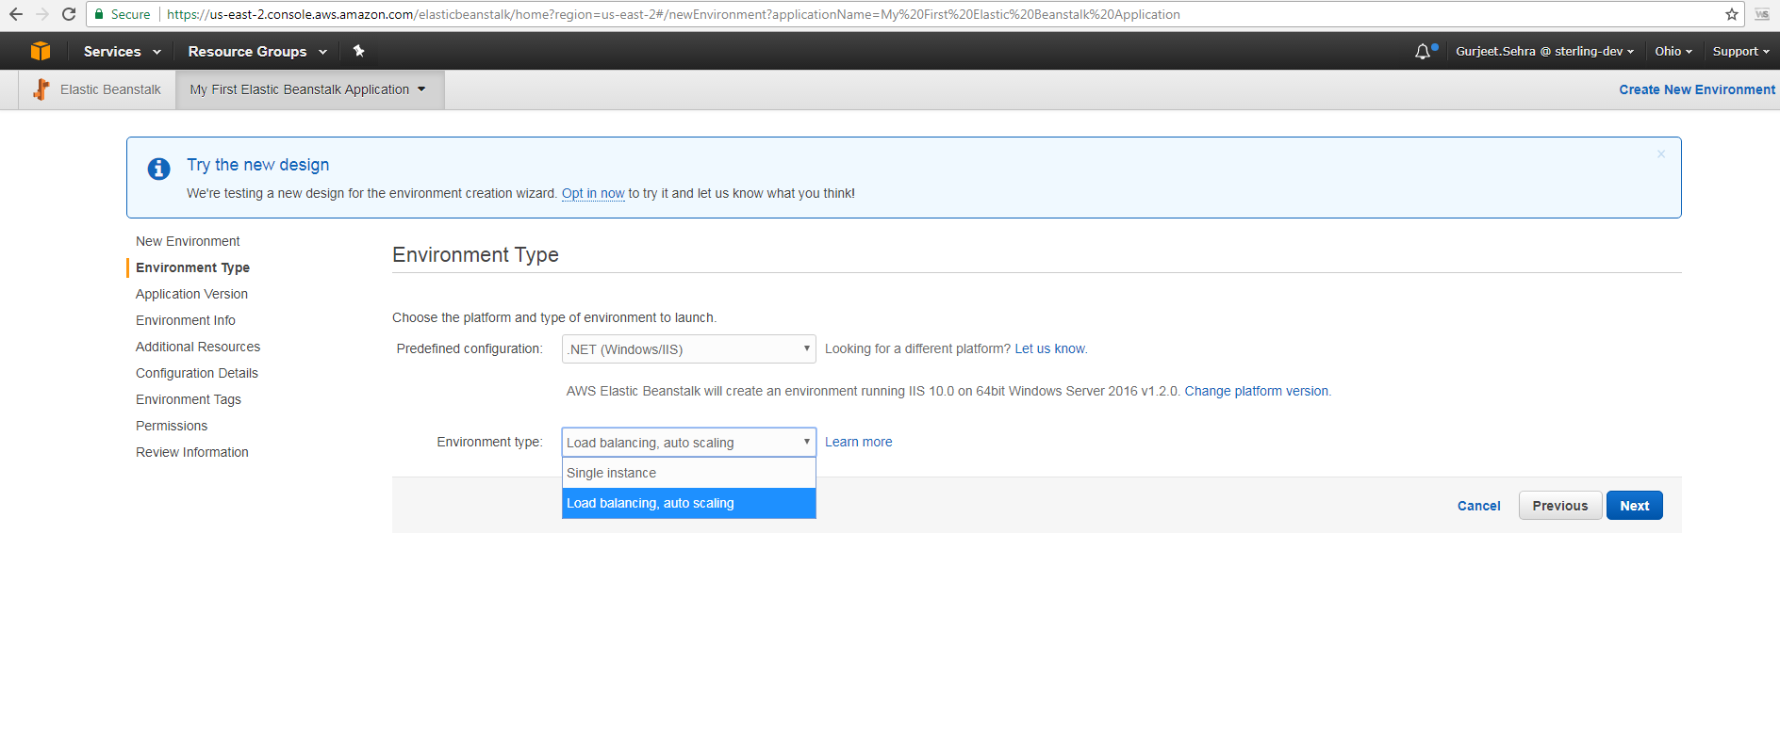
Creating Environment – Step 2

Slide 17
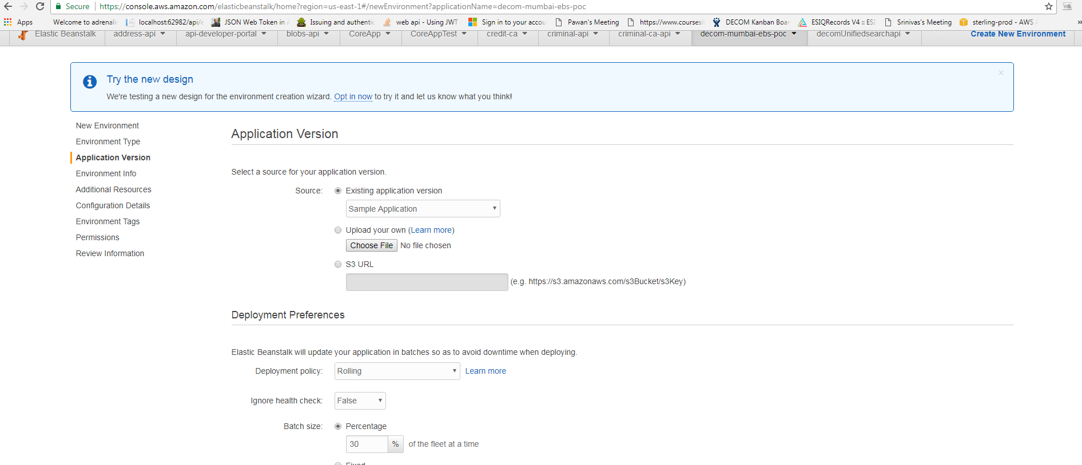
Creating Environment – Step 3

Slide 18
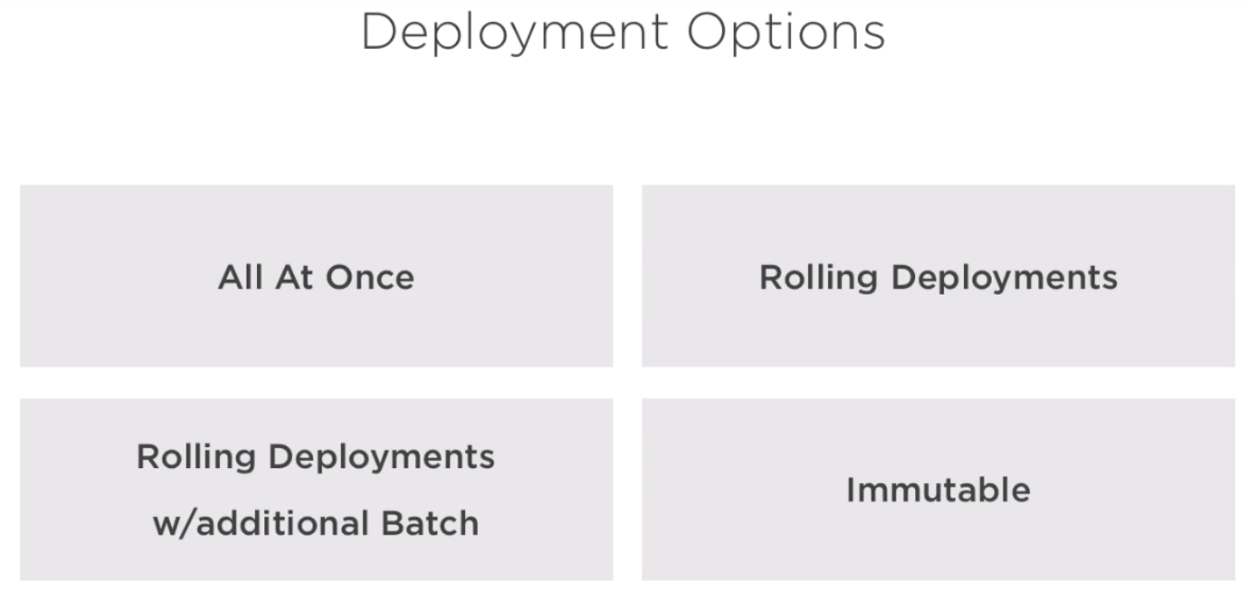
Creating Environment – Step 3

Slide 19
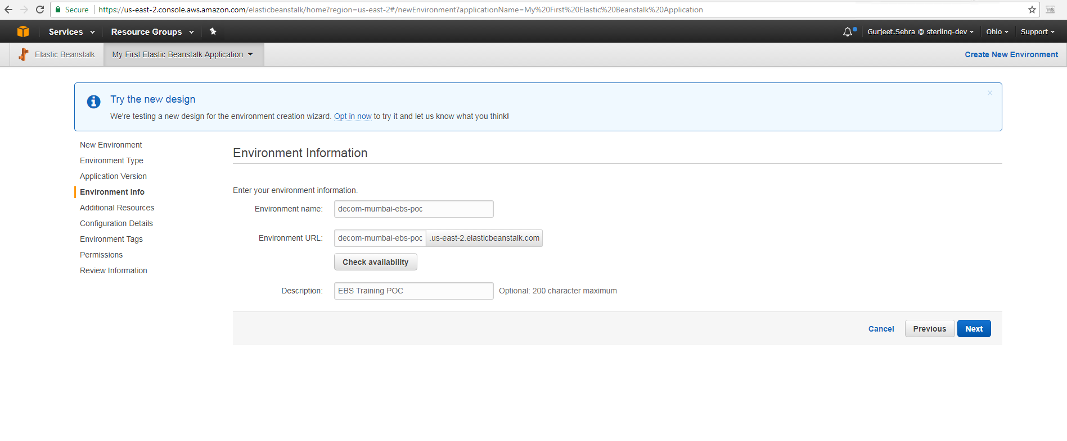
Creating Environment – Step 4

Slide 20
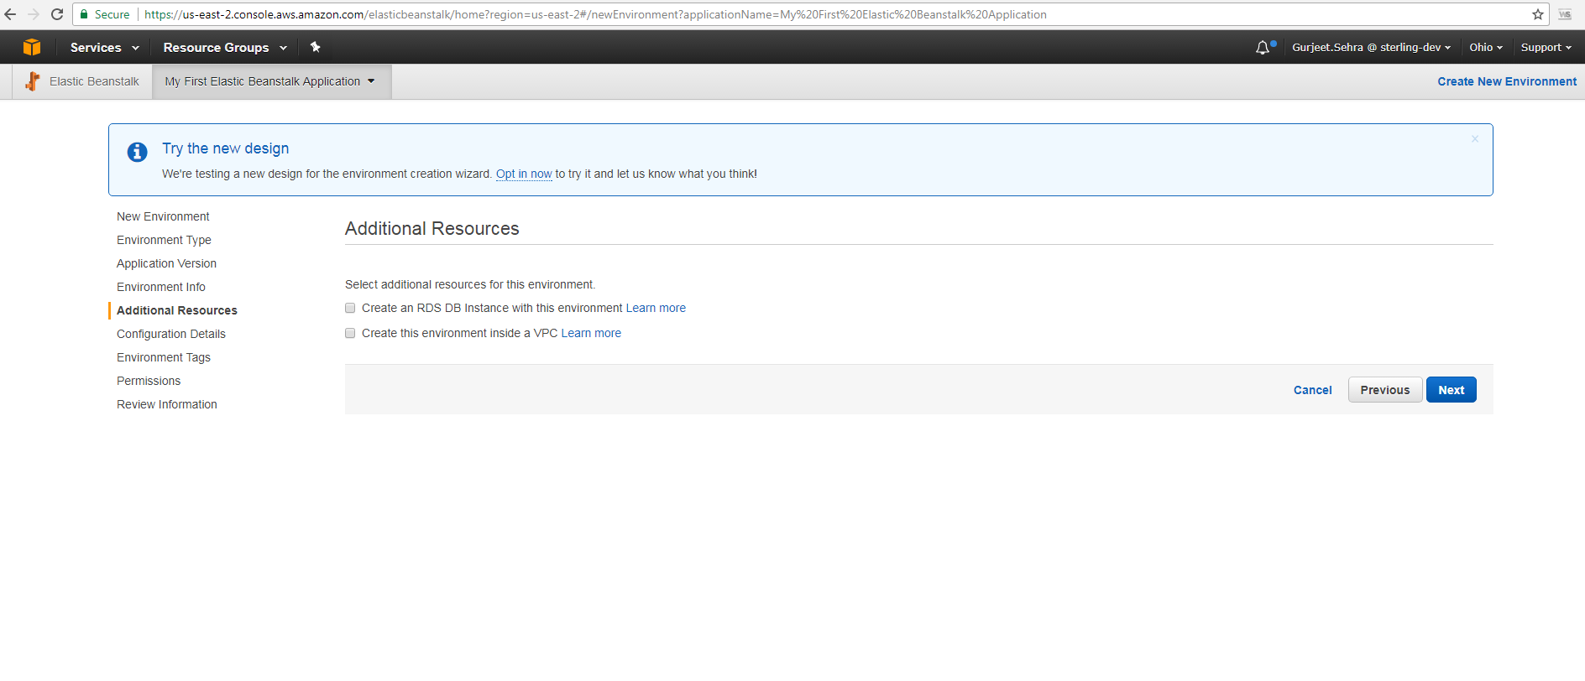
Creating Environment – Step 5

Slide 21
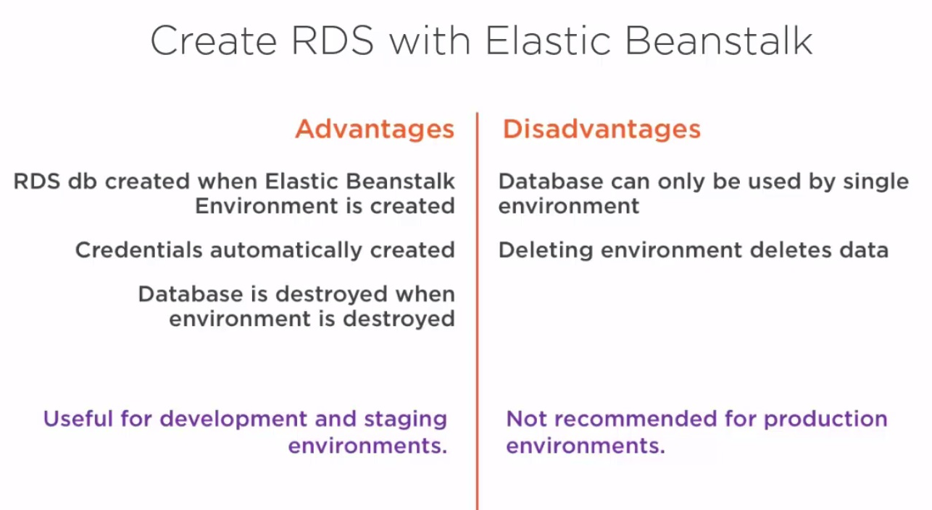
Creating Environment – Step 5

Slide 22
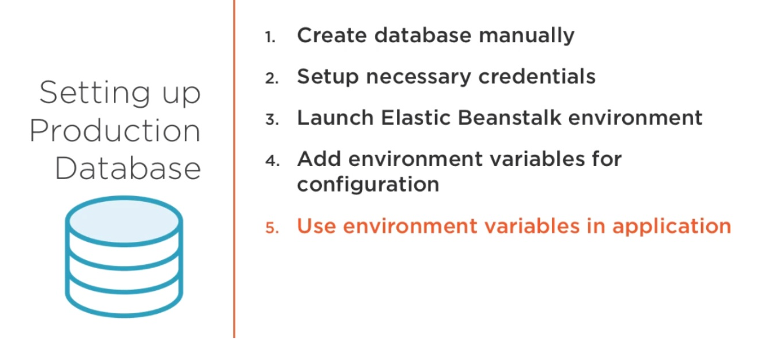
Creating Environment – Step 5

Slide 23
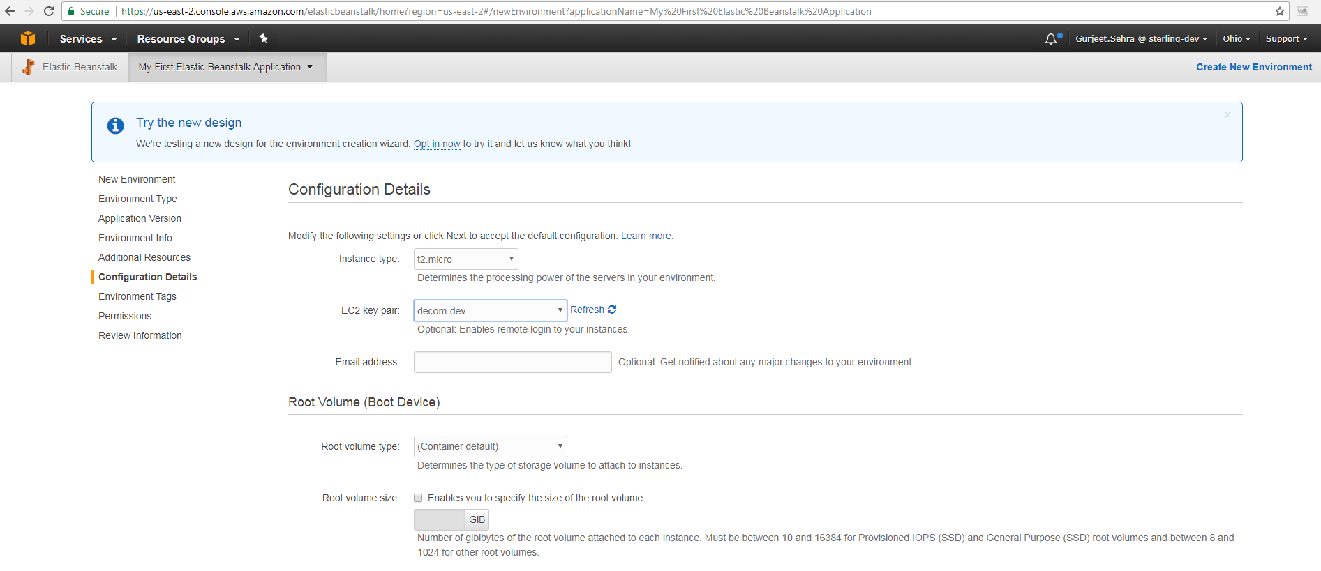
Creating Environment – Step 6

Slide 24
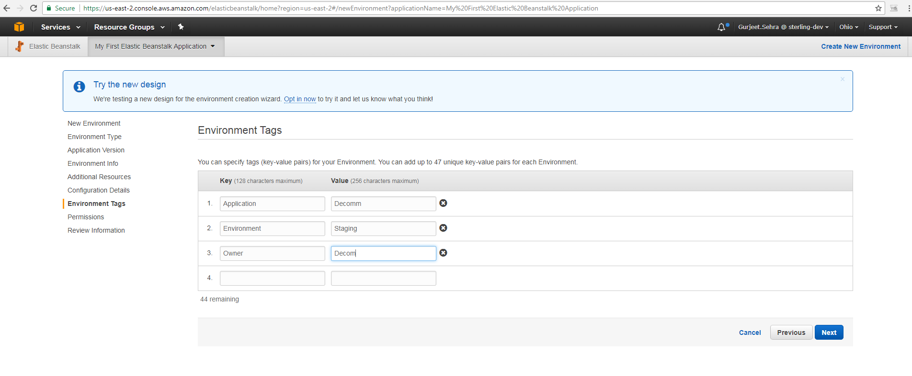
Creating Environment – Step 7

Slide 25
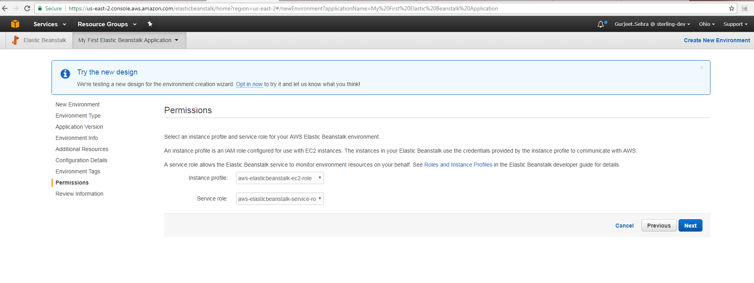
Creating Environment – Step 8

Slide 26
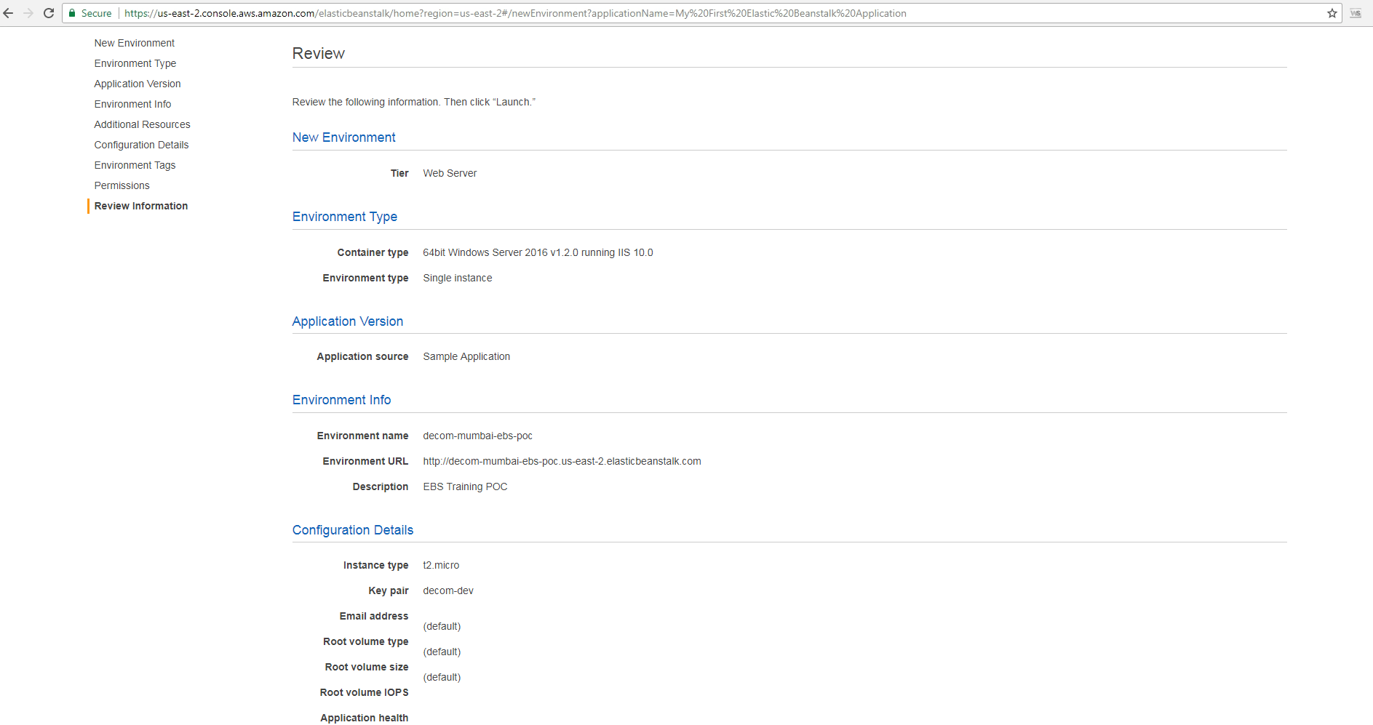
Creating Environment – Step 9

Slide 27
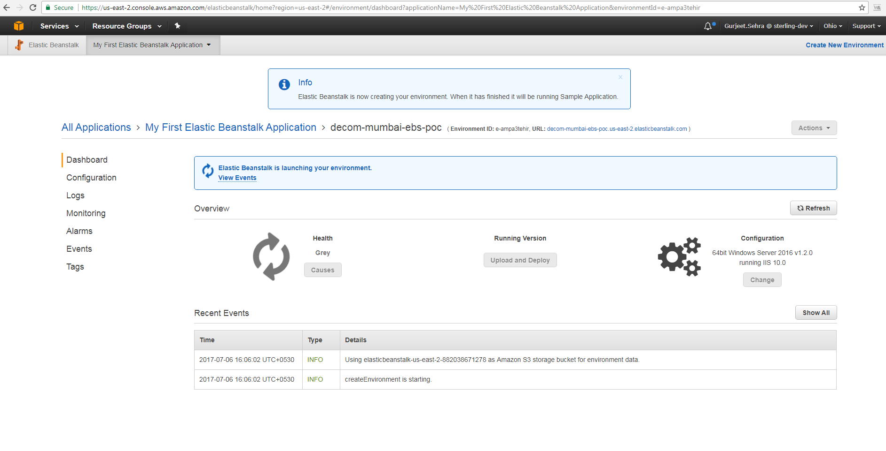
Creating Environment – Step 10

Slide 28
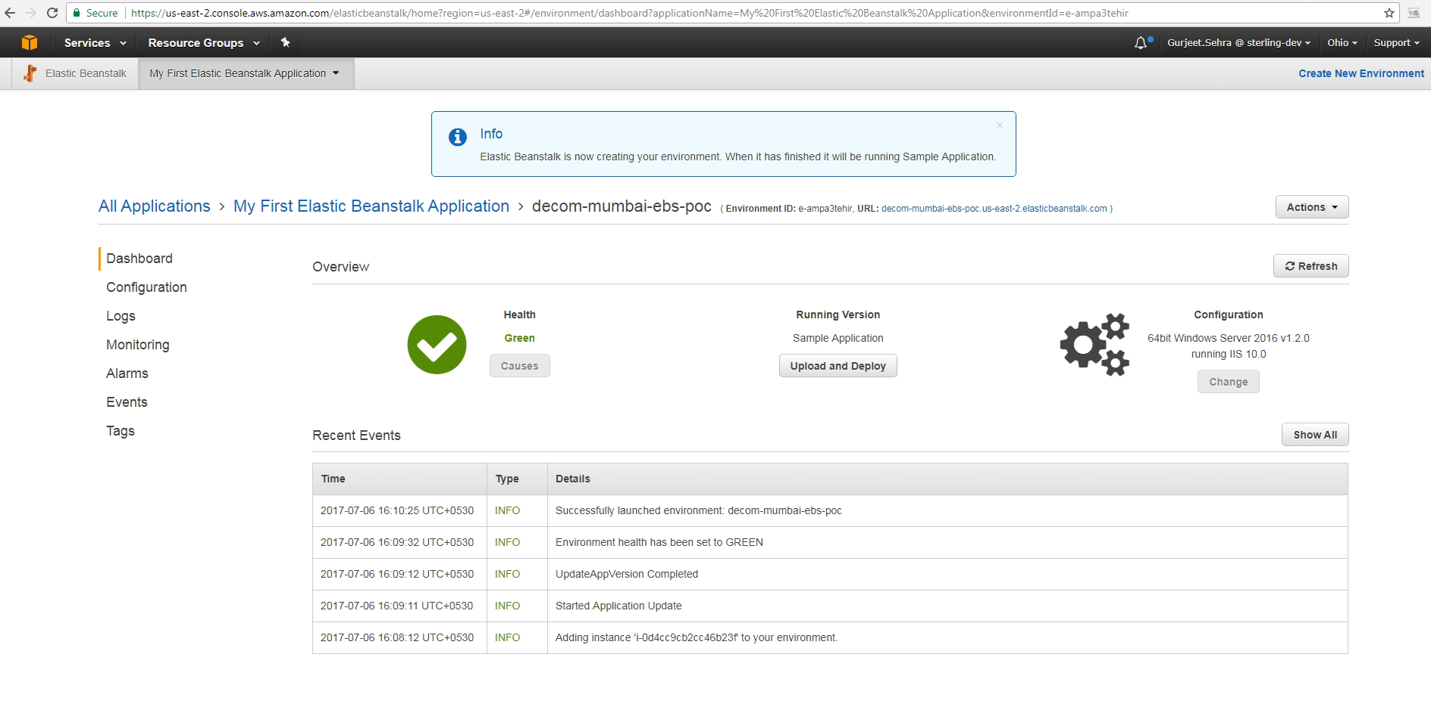
Creating Environment – Final step

Slide 29
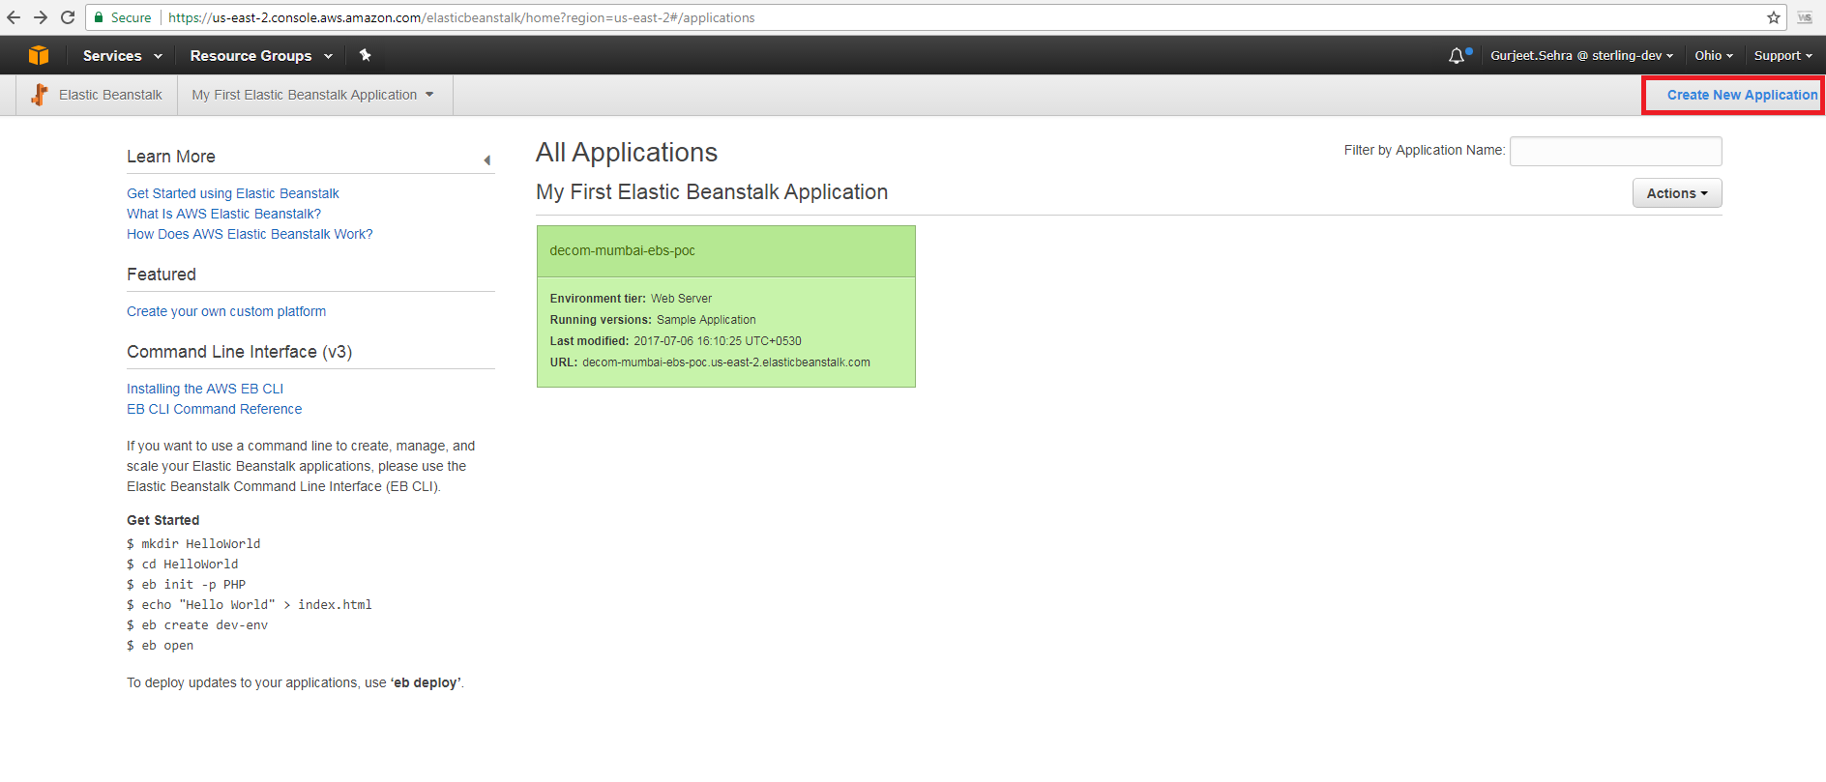
Creating Application

Slide 30
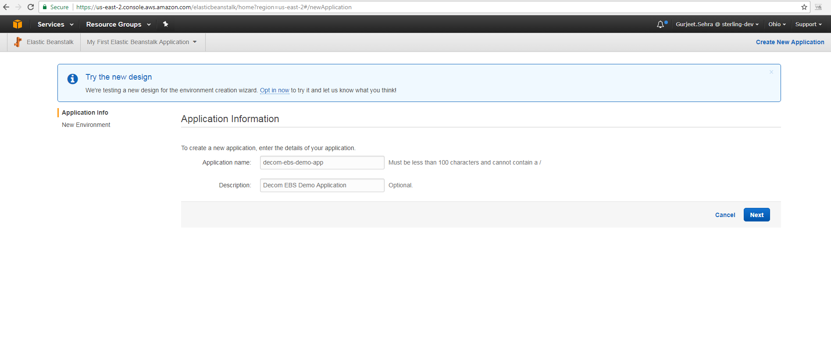
Creating Application

Slide 31
Upload/Deploy Application
There are 2 ways to Deploy application (.Net Application)
Build Package file from VS CMD and Upload AWS Console
Using AWS SDK installed on Visual Studio

Slide 32
Upload/Deploy Application (Build Package file from VS CMD )
Process:
Create Web Application in VS and build solution.
After successful building of application create a package file from the below command using MSBuild VS Command Prompt/VS Command Prompt
Command : C:/> msbuild <path of project file .csproj> /t:Package /p:DeployIisAppPath="Default Web Site“
This will create a package file with .zip in the project’s \obj\Debug\Package folder.
This .zip file need to be upload to AWS console.

Slide 33
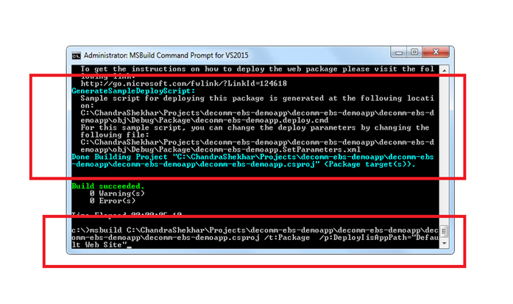
Upload/Deploy Application (Build Package file from VS CMD )

Slide 34
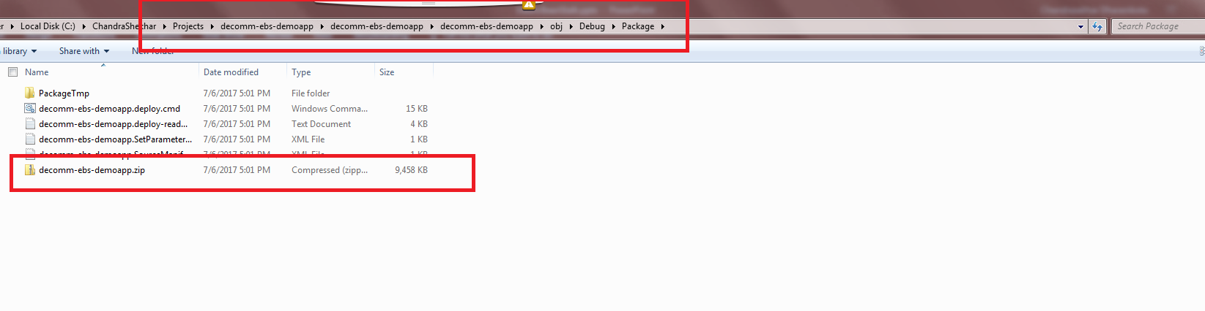
Upload/Deploy Application (Build Package file from VS CMD )

Slide 35
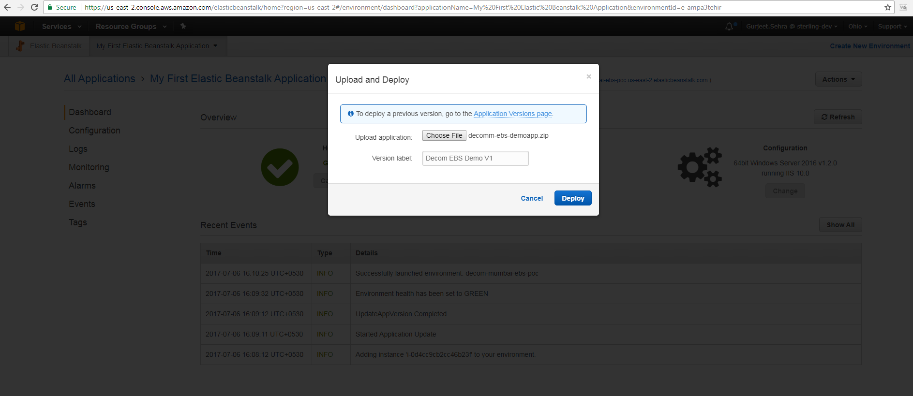
Upload/Deploy Application (Build Package file from VS CMD )

Slide 36
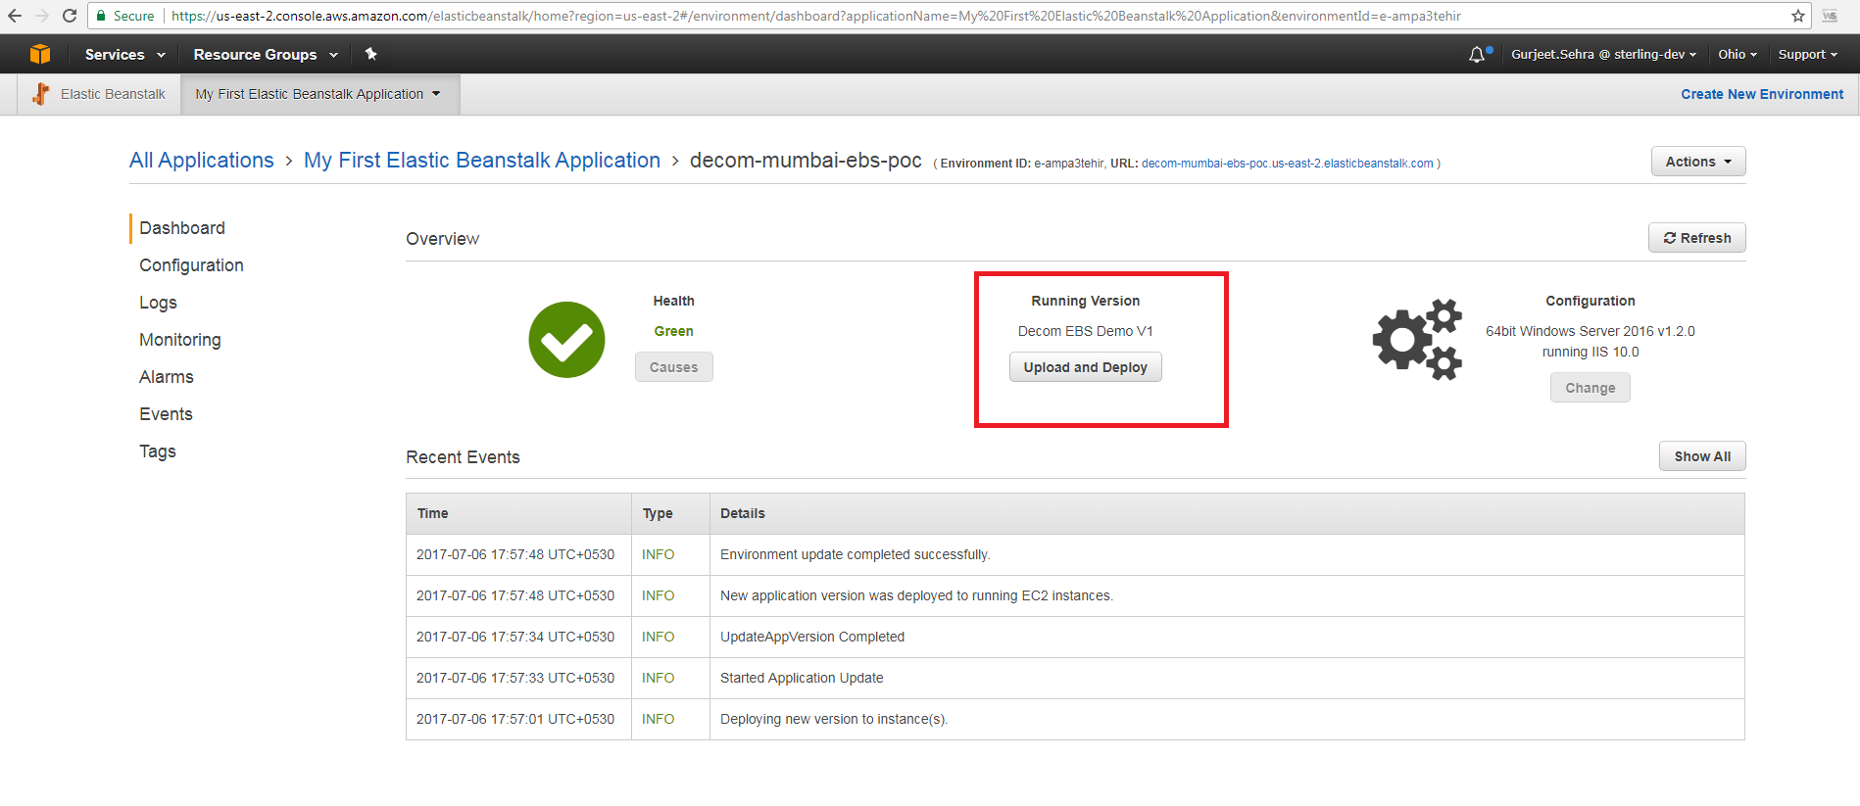
Upload/Deploy Application (Build Package file from VS CMD) – Deployment Successful.

Slide 37
Upload/Deploy Application (Build Package file from VS CMD)
View Deployed application
After successful deployment, browse the below URL to preview the deployed application.
The below URL is created by AWS with environment as subdomain name.
URL Format: http://{environmentname}.us-east-2.elasticbeanstalk.com/
In Our Demo : http://decom-mumbai-ebs-poc.us-east-2.elasticbeanstalk.com/

Slide 38
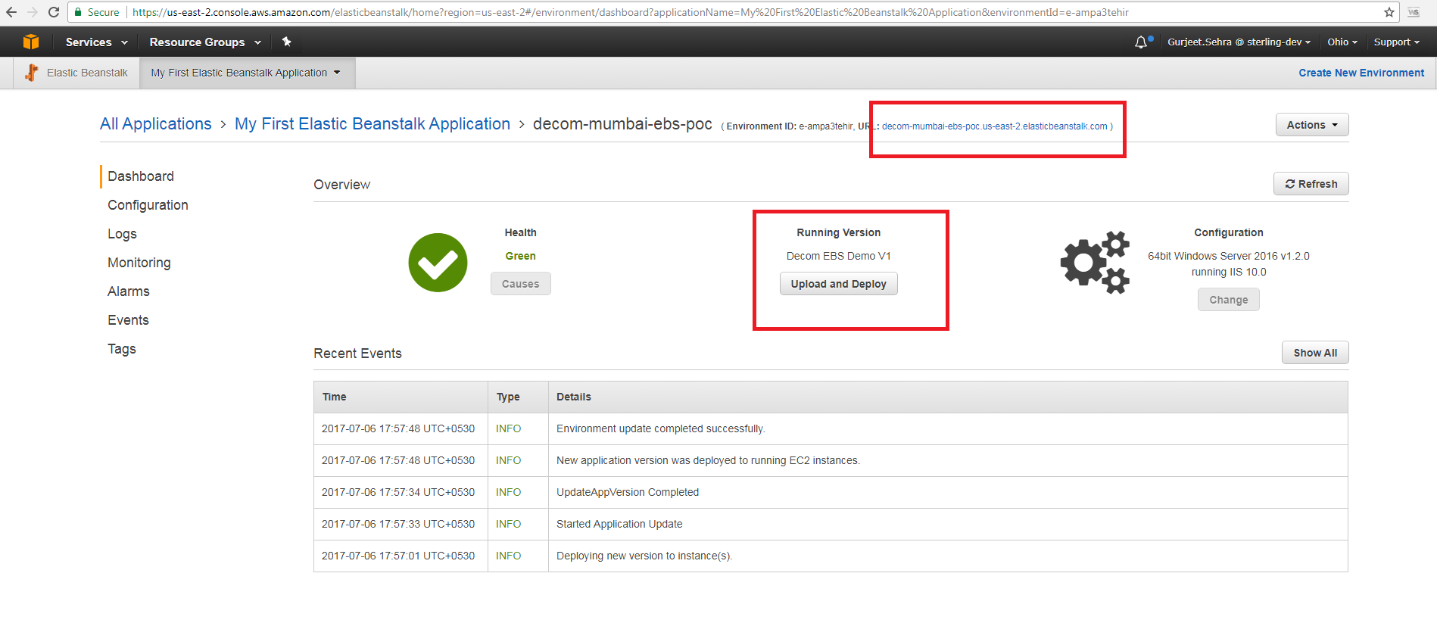
Upload/Deploy Application (Build Package file from VS CMD) – Deployment Successful.

Slide 39
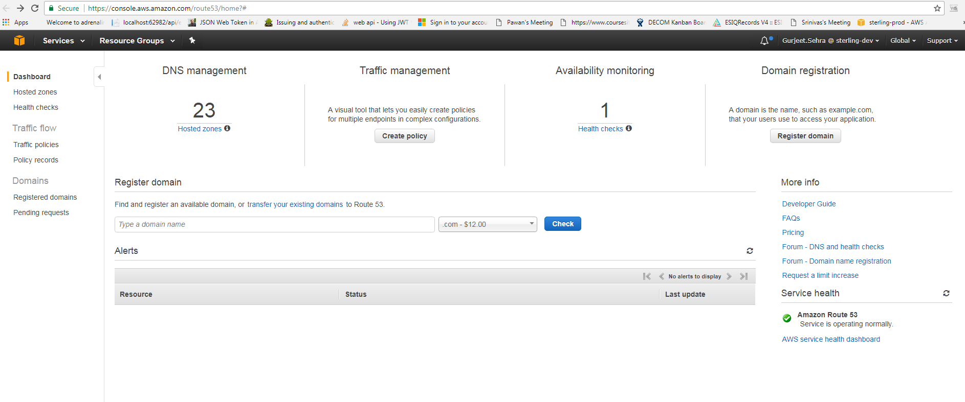
Customize Application Domain URL
Using AWS Route 53 we can map our own domain name to Elastic Beanstalk.
Documentation available here : AWS Route 53

Slide 40
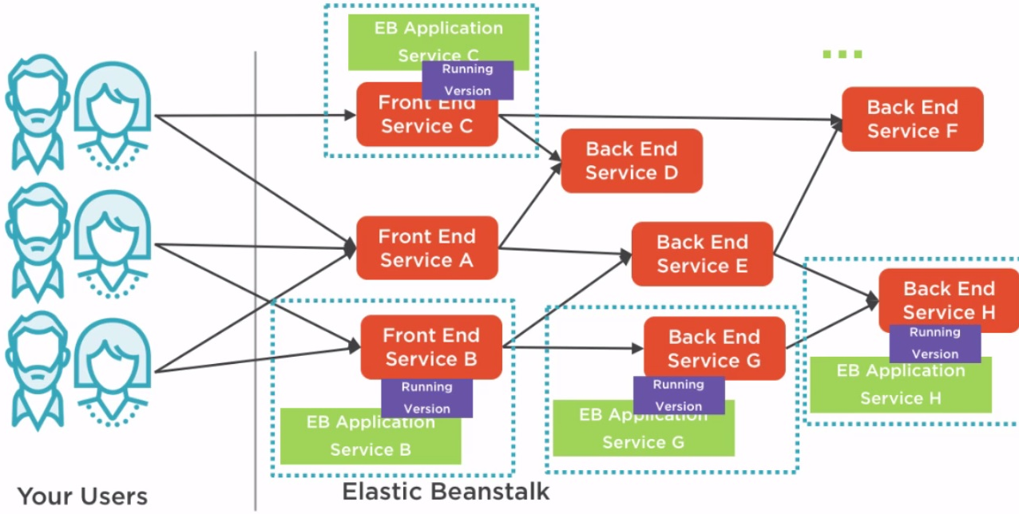
Multiple Environment Application
We can deploy the same application in Multiple environments with same version or different version.

Slide 41
Pricing
There is no additional charge for AWS Elastic Beanstalk.
Pay for AWS resources (e.g. EC2 instances or S3 buckets) that create to store and run your application. You only pay for what you use, as you use it.
There are no minimum fees and no upfront commitments.
.

Slide 42
Summary
Elastic Beanstalk helps us to easily deploy updates to our .Net application while also leveraging Amazon’s powerful infrastructure.
Enhancing the deployment process with containers — like Docker — will add even more versatility.
If we’re looking to reduce system operations and just focus on what you’re developing, Elastic Beanstalk is a solid choice.

Slide 43
References
http://docs.aws.amazon.com/elasticbeanstalk/latest/dg/Welcome.html
https://aws.amazon.com/documentation/elastic-beanstalk/
http://jayendrapatil.com/aws-elastic-beanstalk/

Slide 44
Thank you

